Slide 1
Te Ngau o Horotiu - Ferry Basin Redevelopment
Eric van Essen – Project Director, Auckland Transport
Rachel Kirk – Senior Project Manager, TSA Management

Slide 2
Ferry Basin Redevelopment Context
Downtown Programme - 7 projects for AT/AC; $350M re-vitalization of Auckland waterfront; 2017 to 2021
Highly accelerated – America’s Cup AC36
Queens Wharf – multiple stakeholders - cruise, ferries, Cloud events, public space, commercial and retail businesses, residential nearby
Design partnered with mana whenua – 3 elements
Masterplanning opportunity – Te Ngau o Horotiu (Ferry Basin Redevelopment) and Te Wananga (new Downtown Public Space)
New ferry infrastructure – unprecedented scale for NZ
Limited local knowledge

Slide 3
Te Ngau o Horotiu (Ferry Basin Redevelopment)
Eric’s Personal Reflections

Slide 4
Ferry Basin Redevelopment Challenges
Tight programme
Stakeholder Engagement – public notified RC
Procurement selection – ECI to NZS:3910 with TOC
Collaboration and co-location
For local supplier market: Mansons, SPI, NZForce
Innovation in AT process required – concurrent activities with risks
Risk Management – tight management, COVID impact, scope removal
PM required to be agile

Slide 5
Te Ngau o Horotiu (Ferry Basin Redevelopment)
Rachel’s Personal Reflections

Slide 6
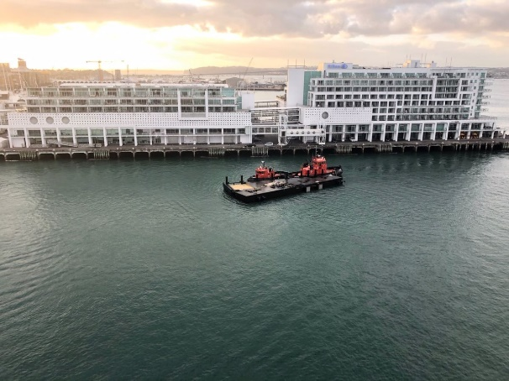
Te Ngau o Horotiu

Slide 7
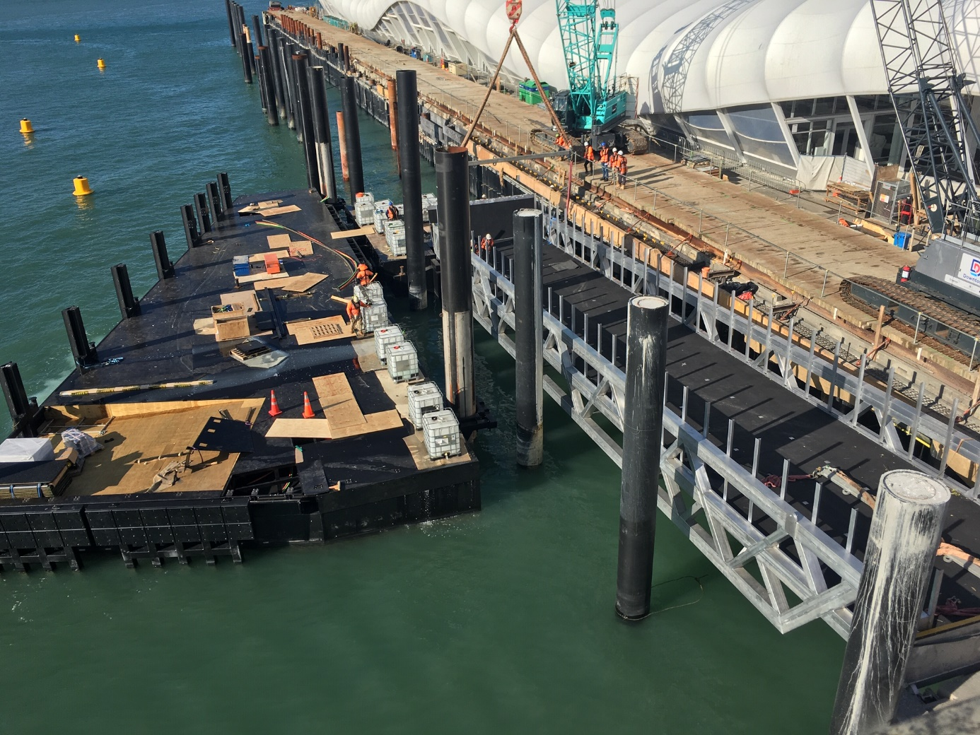
Te Ngau o Horotiu

Slide 8
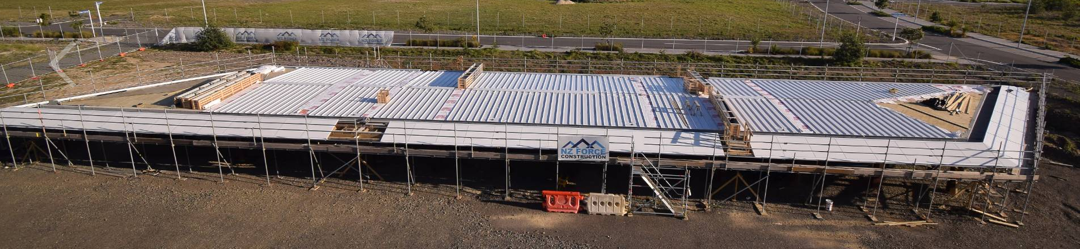
Te Ngau o Horotiu

Slide 9
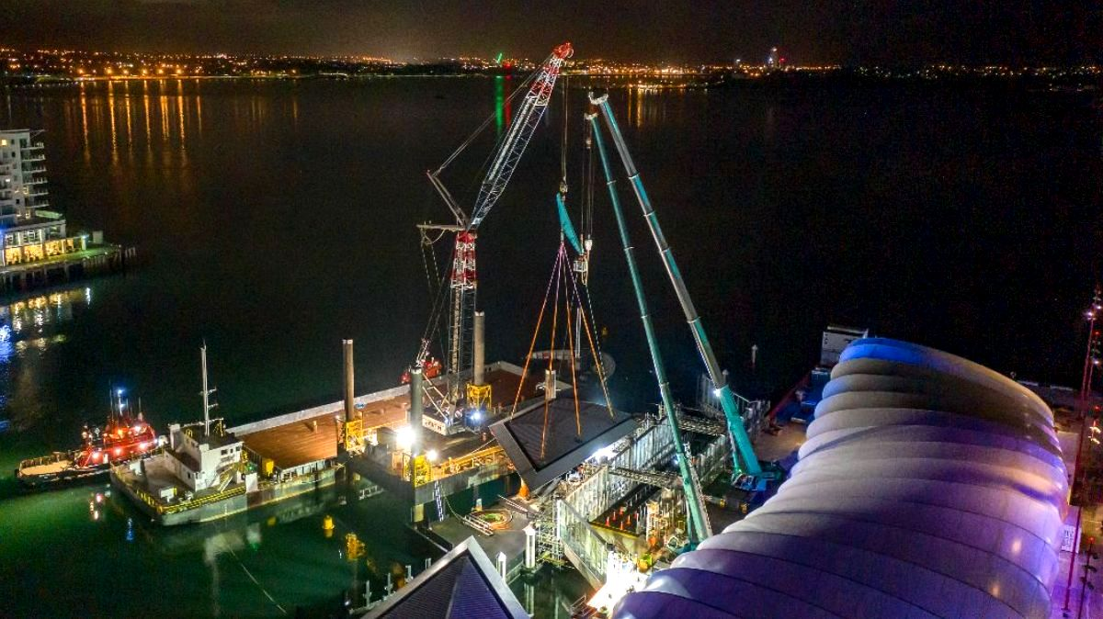
Te Ngau o Horotiu

Slide 10
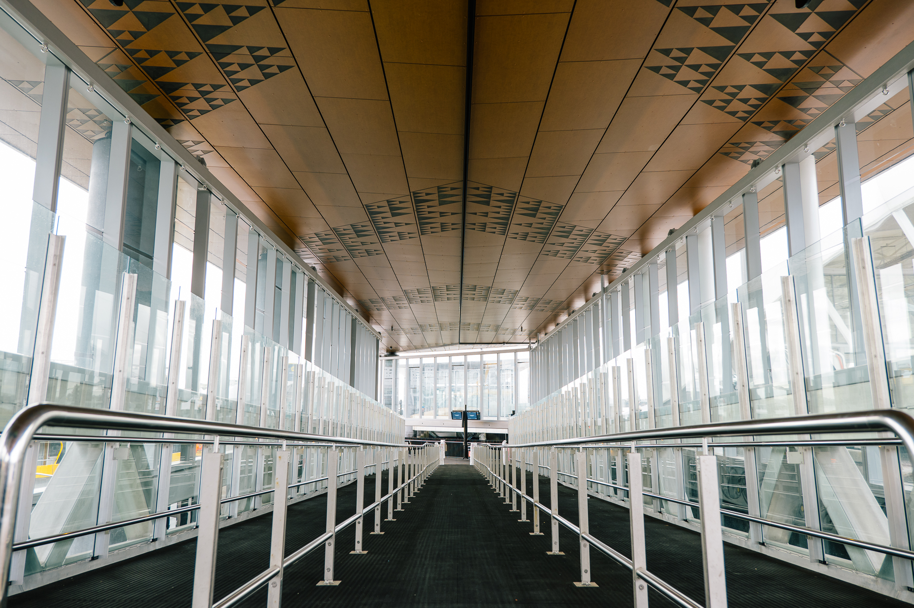
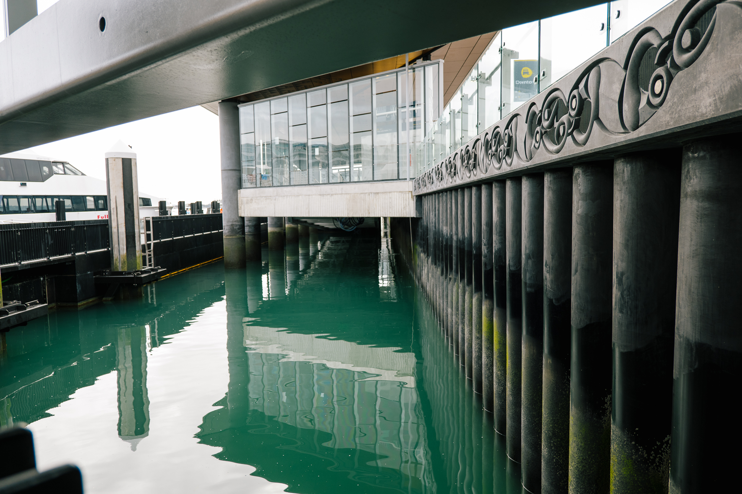
Te Ngau o Horotiu

Slide 11
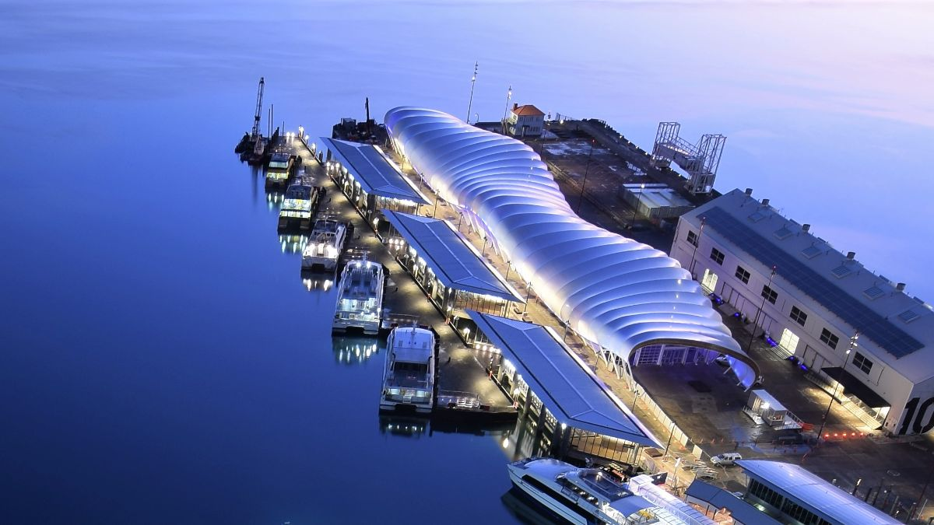
Te Ngau o Horotiu

Slide 12
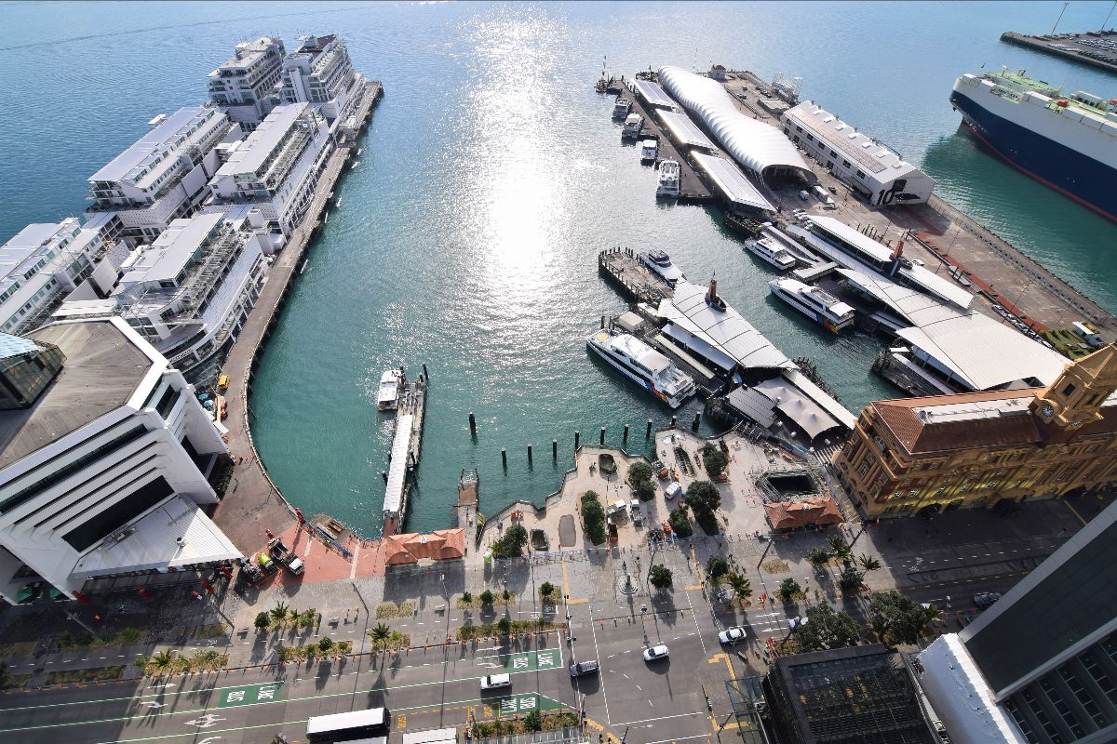
Downtown Waterfront – June 2021

